Slide 1




Attempted microbial control of coconut rhinoceros beetle, Oryctes rhinoceros, Biotype G on Guam using Oryctes rhinoceros nudivirus and Metarhizium majus
Aubrey Moore
Roland J. Quitugua
Ian Iriarte
International Congress of Invertebrate Pathology and Microbial Control and the 51st Annual Meeting of the Society for Invertebrate Pathology
Gold Coast, Australia
13 August 2018
Sean D.G. Marshall
Trevor A. Jackson

Slide 2
Outline
CRB Biology
Failed Eradication Attempt
  Sanitation
Alternate Control Methods
  Chemical control
  Trapping
  Biological control
    Metarhizium majus
    Oryctes rhinoceros nudivirus (OrNV)

Slide 3




Thanks for support and funding from:
US Dept of Agriculture
Animal Plant Inspection Service
US Dept of Agriculture
Forest Service
Legislature of Guam
US Dept of the Interior
Office of Insular Affairs
Notes:
Add DOI-OIA

Slide 4
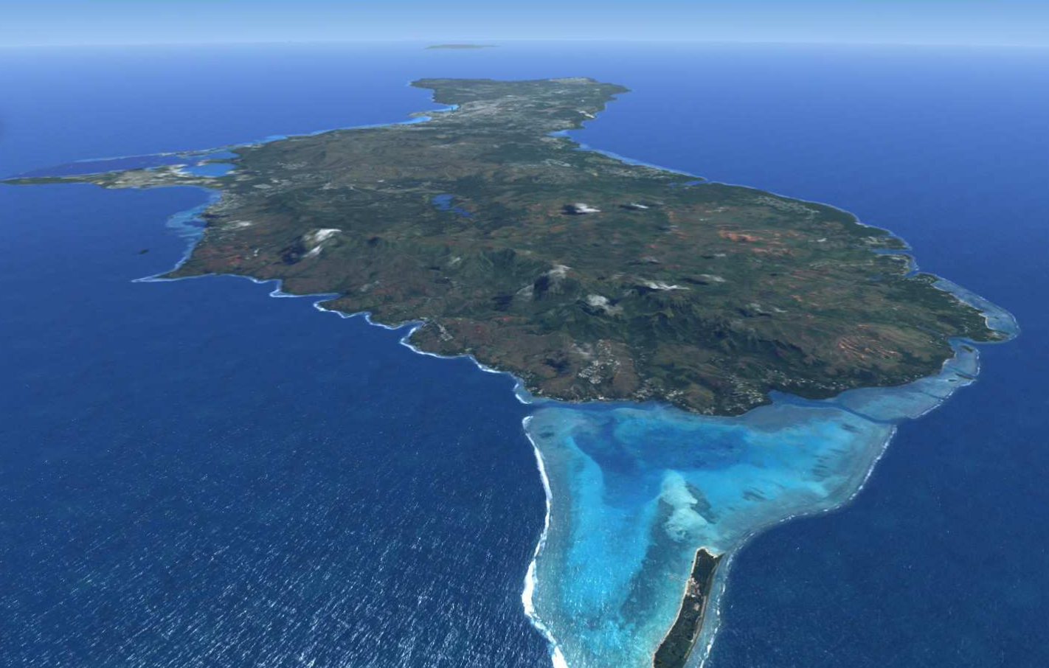
Guam

Slide 5
Notes:
This is the first CRB collected on Guam
Sept. 11, 2007

Slide 6
Coconut Rhinoceros Beetle Biology

Slide 7
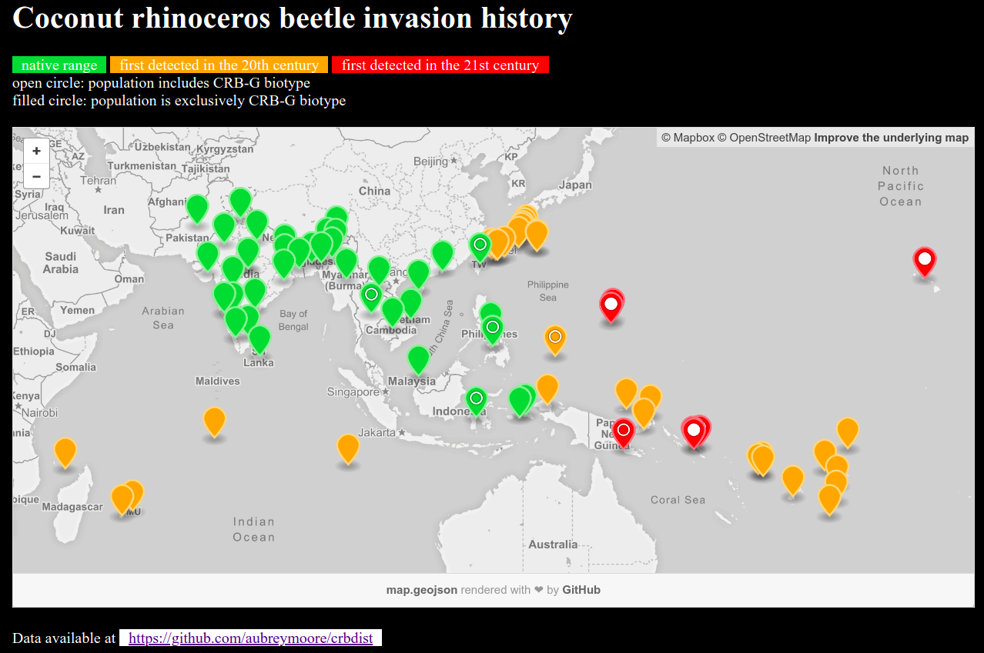
Screen capture from http://aubreymoore.github.io/crbdist/mymap.html 2018-08-05

Slide 8
Discovery of the CRB-G Biotype
Marshall, Sean, Maclean Vaqalo, Aubrey Moore, Roland Quitugua, and Trevor Jackson (2015). A new invasive biotype of the coconut rhinoceros beetle (Oryctes rhinoceros) has escaped from biological control by Oryctes rhinoceros nudivirus.
Presented at the International Congress on Invertebrate Pathology and Microbial Control and the 48th Annual Meeting of the Society for Invertebrate Pathology, Vancouver, BC, August 2015.

Slide 9
Characteristics of CRB-G
genetically distinct
resistant to all available isolates of OrNV
more invasive (all 4 recent invasions involve CRB-G)
behavioral differences ???
      not highly attracted to oryctalure
      higher per-capita damage

Slide 10

Notes:
Generation time: 6 to 9 months
Female lays about 100 eggs (biotic potential of 50
which equals an increase of 5000% per generation)
Only adults do damage.

Slide 11

Notes:
Typical habitat for grubs.
Grubs are found in many types of substrate high in organic matter such as decaying vegetation, manure piles, sawdust piles
In the lab, we rear CRB from egg to adult in a store-bought blend of steer manure and soil.

Slide 12


Notes:
Artificial habitat for grubs.
CRB grubs often found in packaged soil products.

Slide 13

Notes:
- Adults bore into crowns of coconuts or other palms to feed on sap.
- Adults leave the bore hole after 2 or 3 days.
- Adults feed several times.
- Developing fronds are damaged when a beetle bores through them.
- Palms are killed if the meristem is damaged.
- Palms may regrow a full canopy of CRB damage is stopped. However, bore holes do not heal, leaving palm structurally week and succeptible to beheading in strong winds.

Slide 14

Notes:
CRB adults damage developing fronds when boring into the crown.
When these fronds unfurl, this damage is seen as distinctive v-shaped cuts.

Slide 15

Notes:
Palms killed by adults become preferred breeding sites which generate several generations of grubs.
If CRB adults are abundant, many palms will be killed creating breeding sites which generate even more adults.
This positive feedback cycle may not stop until CRB run out of food after killing most palms.

Slide 16
A Short History of CRB on Guam

Slide 17


Slide 18

Notes:
A delimiting survey indicated that CRB had invaded only a small area of Guam (Tumon Bay and Fafai Beach).
Based on this information, an eradication program was launched.

Slide 19
How to Eradicate CRB
Sanitation: Locate and destroy all active and potential breeding sites.
Quarantine: Close pathways to prevent re-introduction and accidental transport to uninfested areas.
Note: Only one of many CRB eradication programs has succeeded (Niuatoputapu Is., aka Keppel Is., Tonga; 16 km² ).

Slide 20

Notes:
Sanitation is labor intensive.

Slide 21


Slide 22
Additional CRB Control Tactics
Sanitation
Quarantine
Trapping
Chemical control
Biological control
Notes:
While trapping and chemical control are commonly used for population suppression as part of an eradication program, biological control is not.
We were advised not to use resources for biocontrol if we intended to eradicate.

Slide 23

Trapping
Pheromone traps baited with oryctalure proved useless for population suppression
Pheromone traps are useful for detection and monitoring
Notes:
Mass trapping established in Tumon Bay did not protect palms from CRB damage.
Mark-release-recapture studies indicate that panel traps catch only about 1% of the available adult CRB population.

Slide 24


Slide 25

Pheromone Trap Development

Slide 26

UV LED increases Trap Catch
Notes:
Addition of a UV light emitting diode increased pheromone trap catch by 2-3X.
Works as a synergist. Light alone traps very few CRB.

Slide 27

Tekken Trap
Notes:
A specific size of fish gill net, referred to as “tekken” on Guam traps CRB when twine drops into gap behind pronotum.

Slide 28

Tekken Trap (fish net)

Slide 29

Tekken Trap
Notes:
Tekken is highly scalable; can be used to cover small or very large piles of breeding site material

Slide 30

DeFence Trap
Notes:
The DeFence trap is an efficient pheromone trap which captures CRB using tekken.

Slide 31
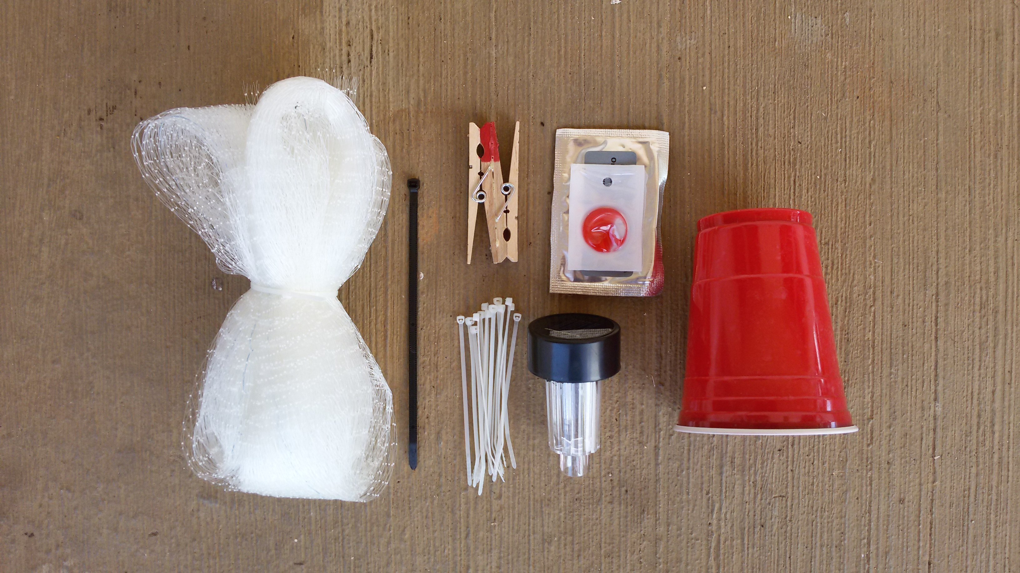
DeFence Trap
Notes:
DeFence trap kit.

Slide 32
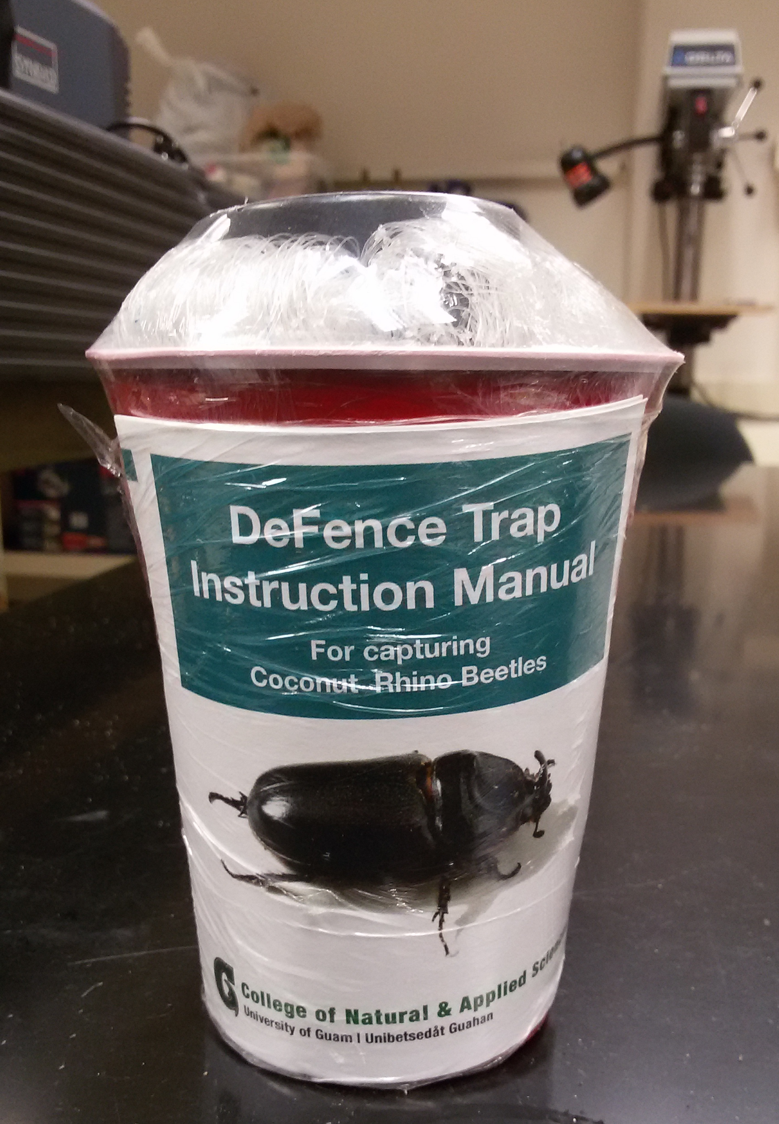

Slide 33

Detector Dogs for Locating Breeding Sites

Slide 34

Detector Beetles for Locating Breeding Sites

Slide 35

Detector Beetles for Locating Breeding Sites
Notes:
33 beetles were tagged and released at 2 sites
19 were successfully tracked to landing sites, 11 of which were considered to be active or potential breeding sites
The remaining 14 beetles were lost when they flew beyond the range of receivers.
Even though all beetles were released in the vicinity of barrel traps (blue dots on this figure) only one (out of 32) was trapped

Slide 36

Chemical Control
Notes:
Palms can be brought back to apparent good health by frequent (biweekly) sprays of cypermethrin
However, bore holes do not heal and attacked palm will always be structurally week.
The spray runs down the petioles and pools where they meet the trunk. This is where CRB initiated their bore holes.

Slide 37
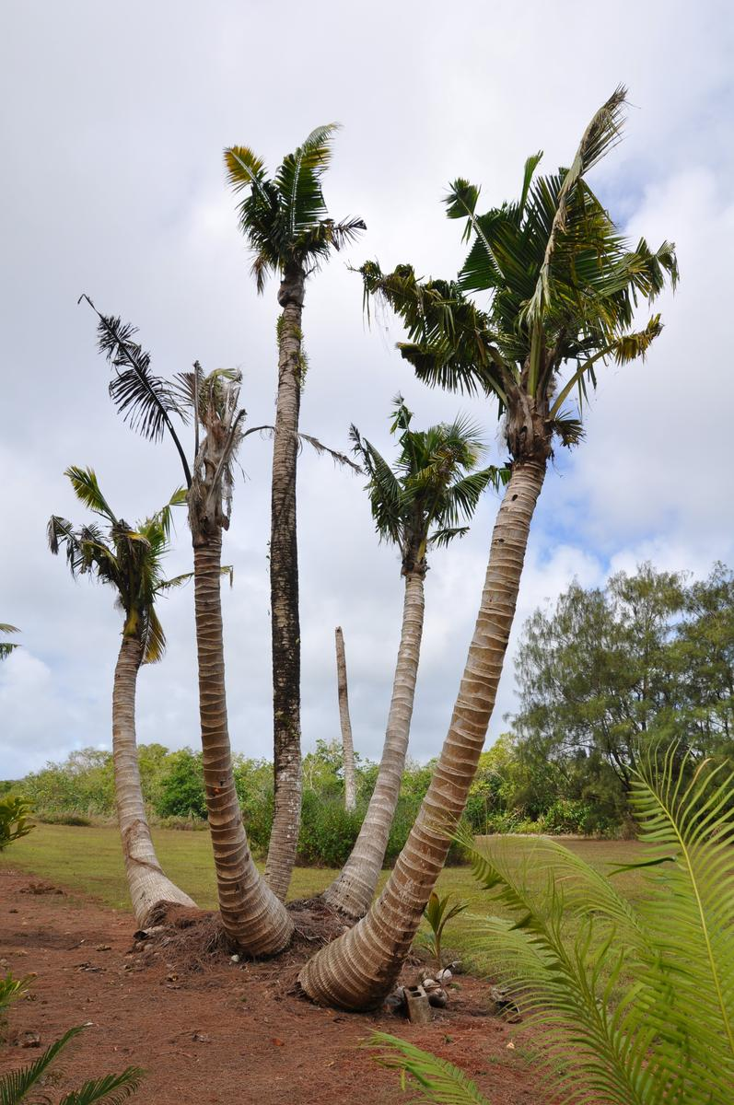
Current CRB Situation on Guam
An uncontrolled CRB outbreak is killing large numbers of coconut palms.

Slide 38

The current outbreak was triggered by Typhoon Dolphin which visited Guam in May 2015. Adult CRB emerging from abundant breeding sites where numerous to start killing mature coconut palms.
Dead standing coconuts are now generating further generations of CRB which are killing even more palms.

Slide 39
Current Prognosis for Guam
Current tactics of sanitation, trapping, application of Metarhizium may reduce local damage, but will do little to protect palms on an island-wide basis because most breeding sites are inaccessible (in jungle and/or on military bases).
Based on historical data from Palau and elsewhere, it is likely that Guam will loose 50% or more of its coconut palms.
Risk of accidental export of CRB to other islands is high.

Slide 40
What Can Be Done?
Effective biocontrol for CRB-G is probably our best chance of saving Guam's coconut palms on an island wide basis.
The biocontrol agent will probably be an isolate of OrNV from an endemic CRB-G population in Asia.

Slide 41


Biocontrol
Oryctes rhinoceros nudivirus (OrNV)
Green muscardine fungus (GMF)
Metarhizium majus
Notes:
There are few effective biocontrol agents for CRB.
OrNV is the preferred BC agent. Unfortunately the Guam CRB population is apparently resistant to all available isolates.
GMF is usually used as a biological insecticide. It has been successfully established on Guam as a classical BC agent. Based on 21 day mortality data for 1,466 CRB collected from 75
sample sites, it is estimated that between 10% and 38% are being killed by GMF infection.

Slide 42
Metarhizium majus (GMF)
We imported GMF spores from Ambrosio Alfiler’s Philippine Coconut Authority lab in Legaspi.
Distributed by autodissemination and direct application to breeding sites
Released on Guam as a classical biocontrol agent, this fungus established rapidly and spread island-wide

Slide 43
Guam GMF Survey - Methods
1,466 CRB grubs and adults were collected from 77 breeding sites between Oct. 30, 2014 and May 26, 2015.
Beetles were individually collected into Mason jars containing a commercial steer manure blend.
At 21 days, each beetle was examined for mortality an fungal infection.
Technical report available at:
http://guaminsects.net/anr/sites/default/files/1555%20yearend%20report.pdf

Slide 44
Guam GMF Survey - Results
38% of beetles died
10% of beetles died and had signs of fungal infection
We concluded that the mortality caused by GMF was between 10% and 38%
Mortality rate was not correlated with rainfall.

Slide 45
Guam GMF – Current Status 1
Population suppression from GMF and other tactics was not enough to stop the uncontrolled CRB outbreak triggered by Typhoon Dolphin

Slide 46
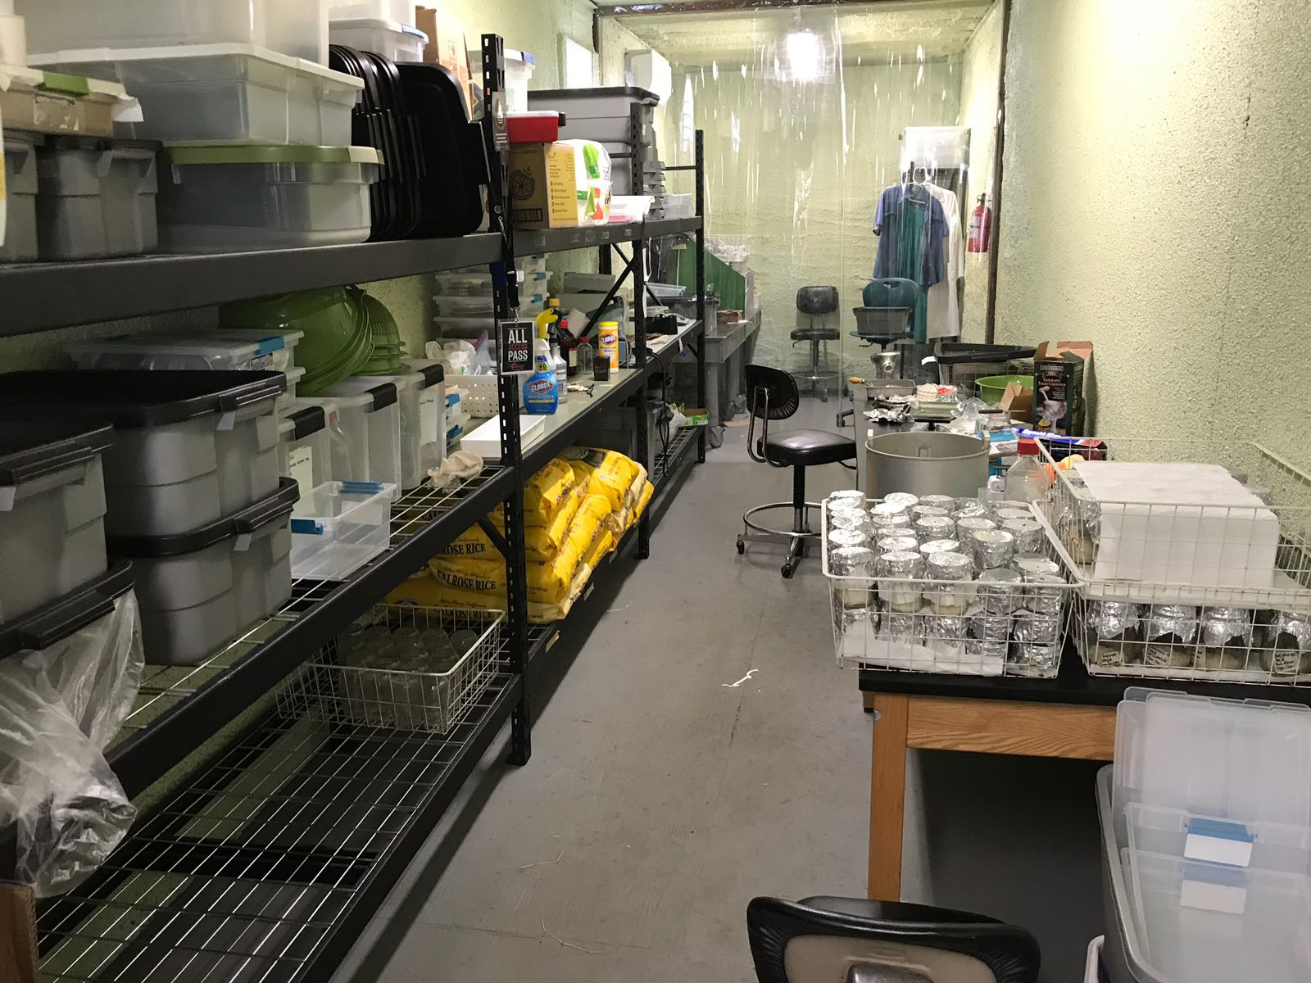
Guam GMF – Current Status 2
Roland Quitugua has established a production facility to provide GMF spores for use as a biological insecticide

Slide 47
OrNV – Negros Island
Our first attempt to find an effective OrNV for biocontrol of CRB-G was an expedition to Negros Island, Philippines in January 2017
Sean Marshall, Ian Iriarte, Aubrey Moore
Technical report: Marshall, Sean and Aubrey Moore 2017. Molecular analyses of Oryctes rhinoceros collected from Philippines (January 2017).

Slide 48
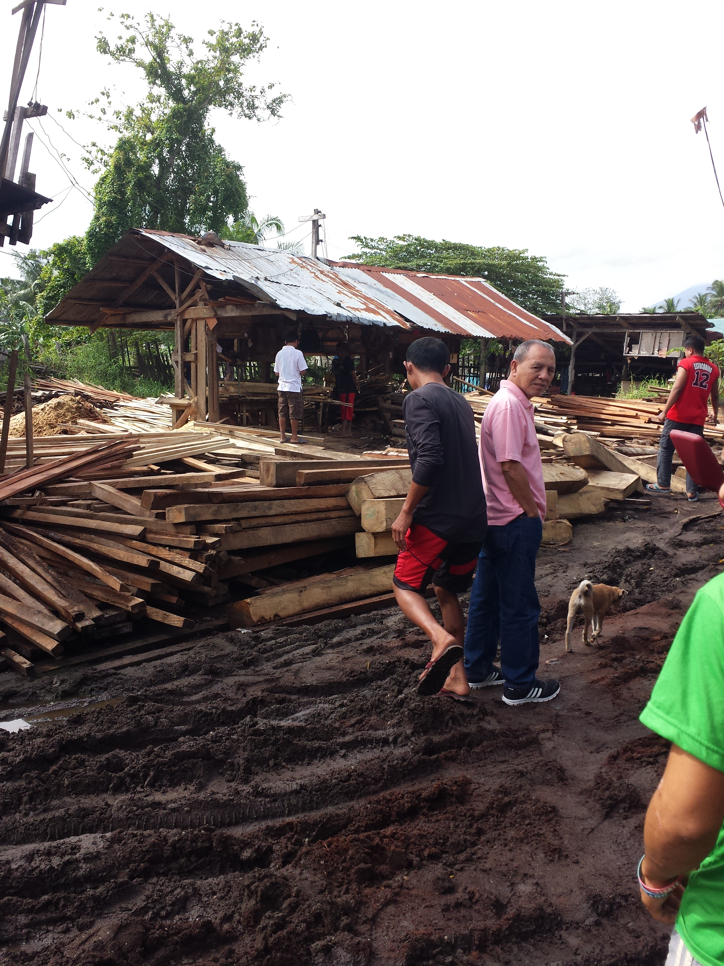
OrNV – Negros Island – Methods 1
We collected grubs and adults by hand and by using pheromone traps

Slide 49
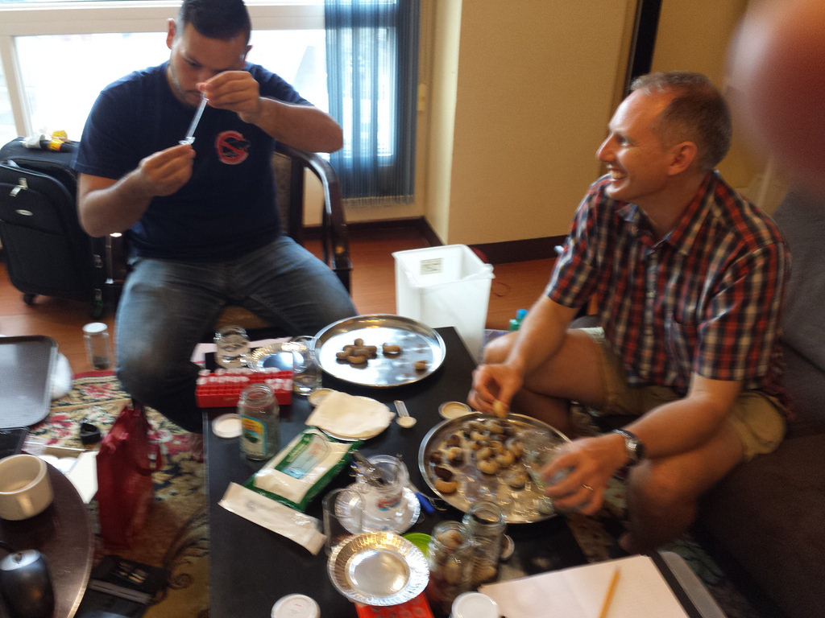
OrNV – Negros Island – Methods 2
Specimens were dissected and gut samples were preserved for molecular analysis and and histology.

Slide 50
OrNV – Negros Island – Results 1
A total of 214 CRB larvae, pupae, and adults were collected
All larvae were collected by hand from breeding sites.
Adults were collected by three methods:
  by hand from breeding sites (n=39)
  attracted to household lighting (n=3)
  in pheromone traps (n=1)
A single OrNV-infected beetle was caught by hand after it appeared at an illuminated house window.
Pheromone traps were ineffective. Only a single beetle was caught in six traps deployed for a total of 31 trap-nights (0.03 beetles per trap-night)

Slide 51
OrNV – Negros Island – Results 2
CO1 barcoding indicated that all tissue samples were from CRB-G
OrNV was detected in tissue samples from only one of 94 beetles using 3 separate methods: visual, DNA, and histology). This sample, Dug42, was form an adult attracted to a household light.
OrNV isolated from Dug42 was propagated in insect cell culture.

Slide 52
OrNV – Negros Island – Results 3
Bioassays of the Dug42 OrNV isolate were performed on Guam using field-collected adults:
  Beetles dosed by application of OrNV to mouthparts resulted no significant response
  Beetles dosed by injection into the haemocoel resulted in no significant response

Slide 53
OrNV – Current Plans
Next foreign exploration will be in Taiwan were there is a population of CRB-G with an OrNV infection rate of 82% (Shizu Watanabe, personal communication).

Slide 54
Regional Approach

Slide 55
CRB-G is a Regional Problem
Jackson, Trevor (2015).
Need for emergency response for a new variant of rhinoceros beetle (Guam biotype).
International Association for the Plant Protection Sciences Newsletter (XI). November, 2015.
Available on-line at
Vaqalo, Maclean, Sean Marshall, Trevor Jackson, Aubrey Moore (2015).
An Emerging Biotype of the Coconut Rhinoceros Beetle Discovered in the Pacific.
Secretariat of the Pacific Community, Land Resources Division.
Available on-line at
Notes:
This OrNV resistant biotype has the potential to invade all coconut growing areas,including new islands and counties in SE Asia where CRB is naturally controlled by OrNV. Effects on coconut and oil palm crops could be disastrous
An emergency response to CRB-G is needed to minimize damage on newly invaded islands, thereby reducing risk of further spread.

Slide 56


Notes:
Loss of coconuts on smaller islands and atolls where people rely on coconut as the “tree of life” will be a human disaster.

Slide 57

Link to Climate Change
Notes:
Sea level in the Solomons has risen 8 mm per year since 1993, killing coconuts which protect the islands from erosion.
Typhoons trigger CRB outbreaks even in areas where the beetle is endemic and under biocontrol by OrNV.
Climate change models predict stronger and more frequent typhoons.

